Slide 1
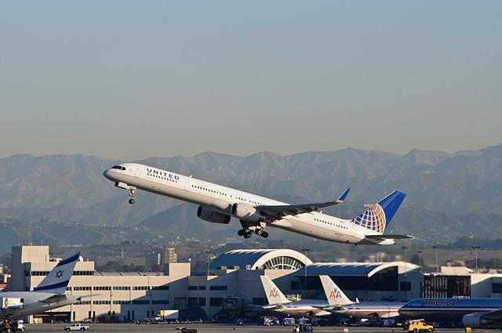
AIRLINE RESERVATION SYSTEM PROJECT
-Presentation by
Group 4
Mentor: Shailaja Patil
Date: 15-09-2022

Slide 2
CONTENTS
1
2
3
4
5
6
Introduction
DFD Diagram
Functions used in the Program
Brief Description of Code
Testing
Program Output

Slide 3
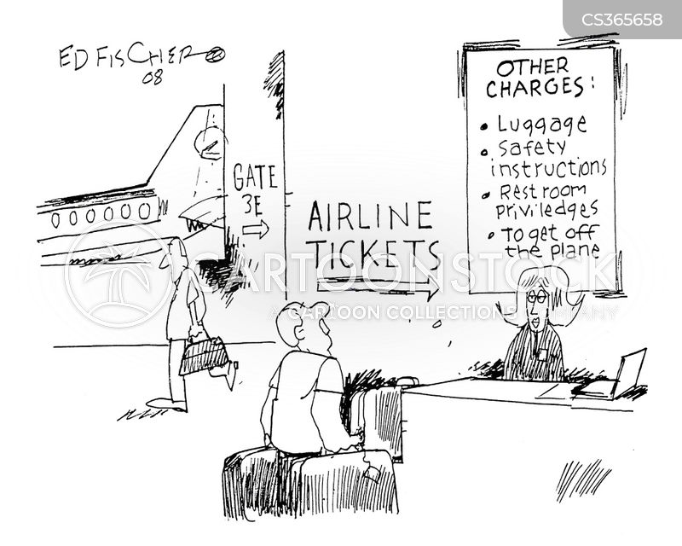
INTRODUCTION
The Airline Reservation System application can be used by Airlines and Travel agents to allocate seats to customers which replaces traditional methods of ticket booking.

Slide 4
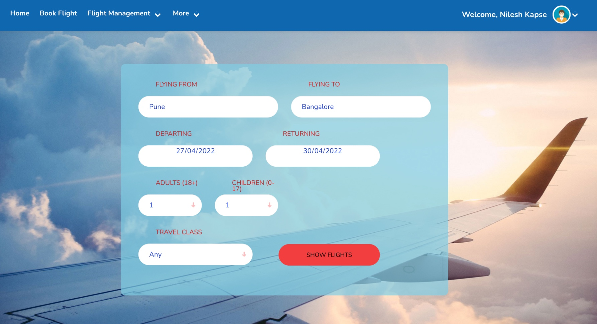
INTRODUCTION

Slide 5
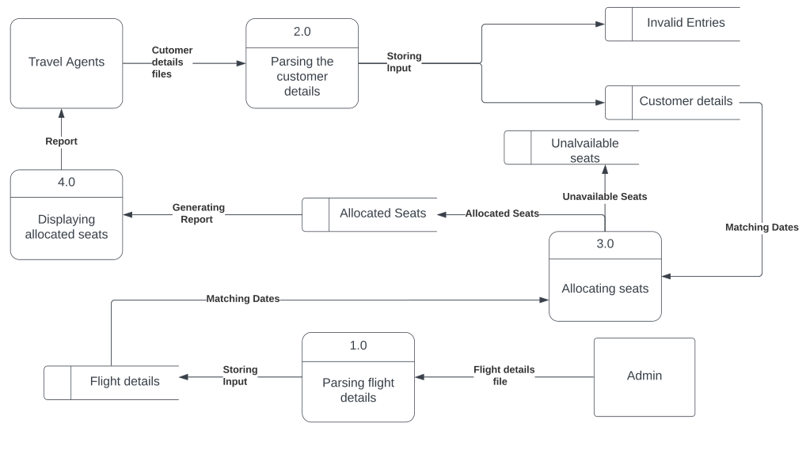
DATA FLOW DIAGRAM (Level 1)

Slide 6
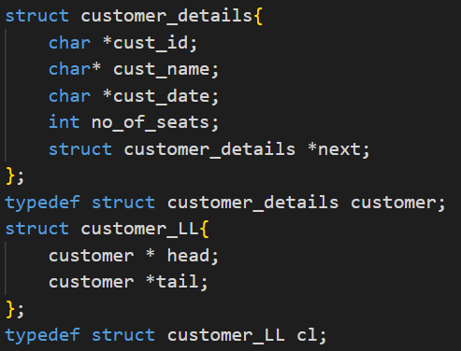
DATA STRUCTURES USED IN THE PROGRAM
Structure (typedef: customer) was created for customer details as shown in the figure.
It consists of Customer- Id, Name, Date, No. of seats & Next pointer
A linkedlist was created to store all the valid customers.

Slide 7
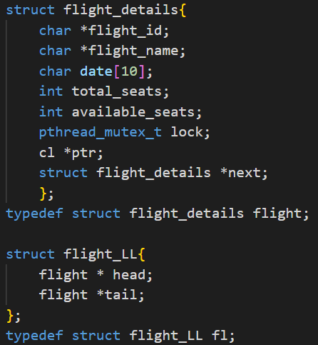
DATA STRUCTURES USED IN THE PROGRAM
Structure(typedef: flight) was created for flight details as shown in the figure.
It consists of flight Id, name, date , total no. of seats, available seats, mutex lock, customer pointer, next pointer
A global linkedlist was created to store all the valid flights.

Slide 8
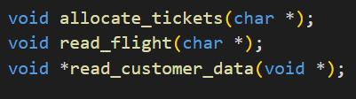
FUNCTIONS USED IN THE PROGRAM
Apart from main function, the other functions used in the program are as follows:
read_flight()- Read the flights file & store data in a global flight linked list.
read_customer_data()- Reads the input file, calls allocate function for valid customers & prints Invalid customer data.
allocate_tickets()- to finally allocate tickets to customers

Slide 9
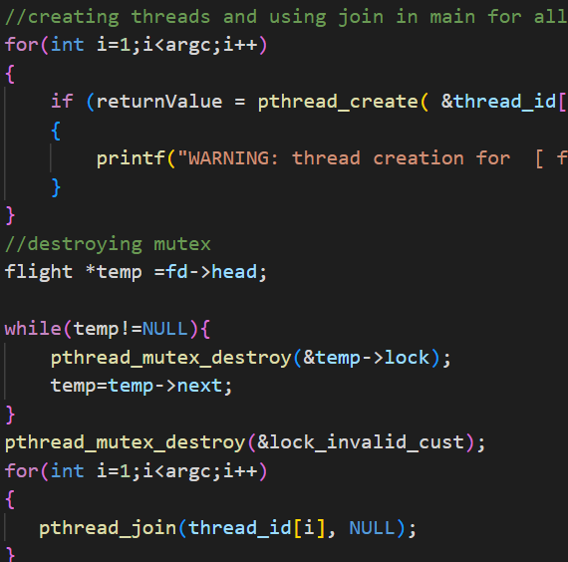
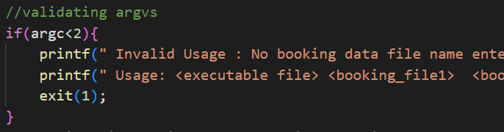
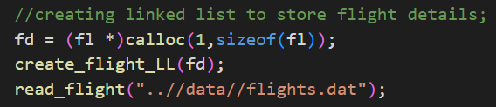
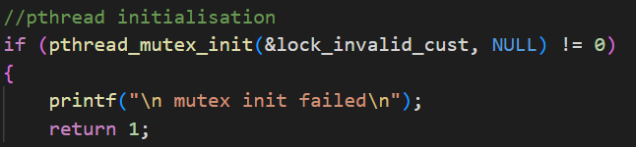
BRIEF DESCRIPTION OF CODE(MAIN FUNCTION)

Slide 10
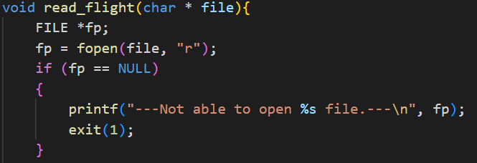
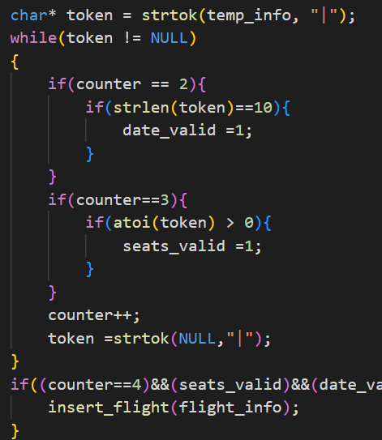
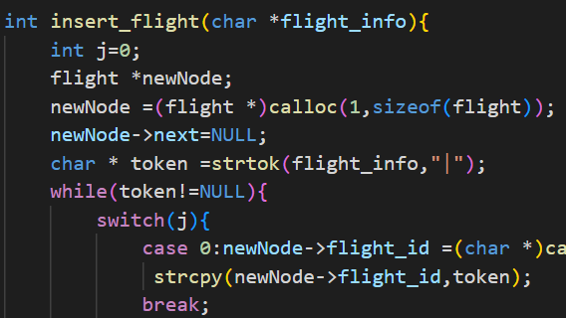
BRIEF DESCRIPTION OF CODE (READ_FLIGHT FUNCTION)

Slide 11
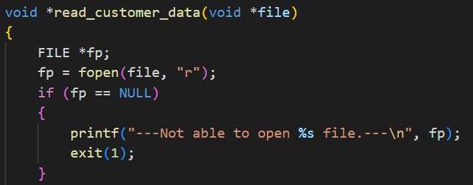
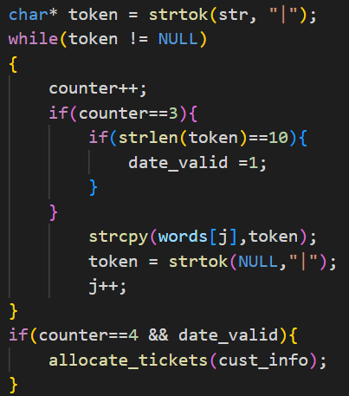
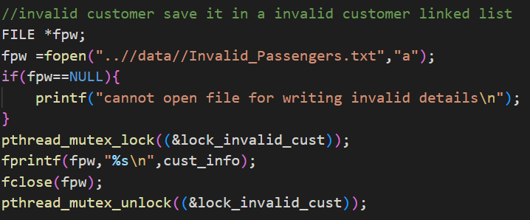
BRIEF DESCRIPTION OF CODE (READ_CUSTOMER_DATA)

Slide 12
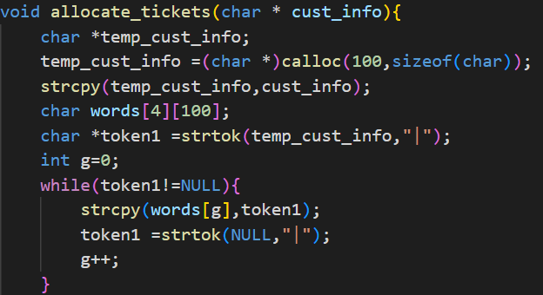
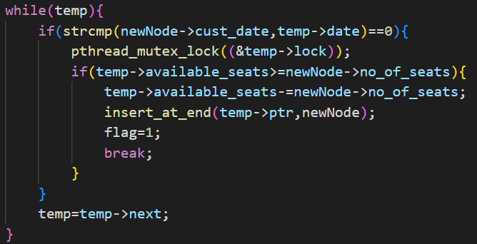
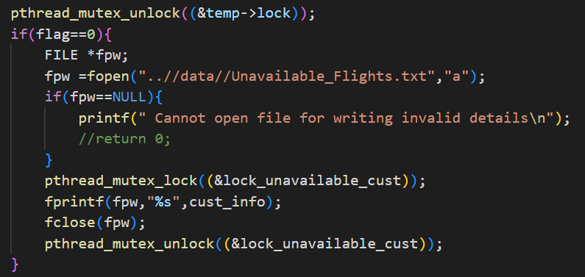
BRIEF DESCRIPTION OF CODE (ALLOCATE_TICKETS)

Slide 13
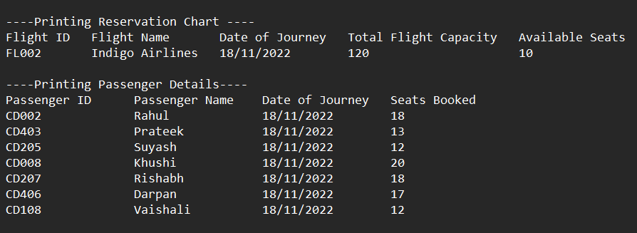
RESERVATION CHART OF A FLIGHT

Slide 14
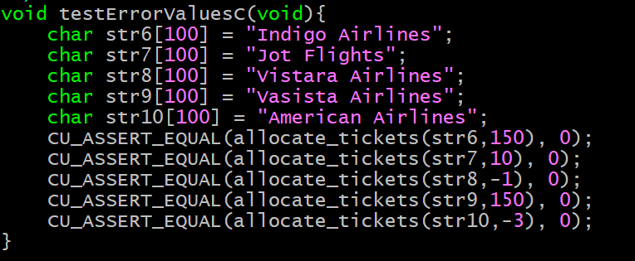
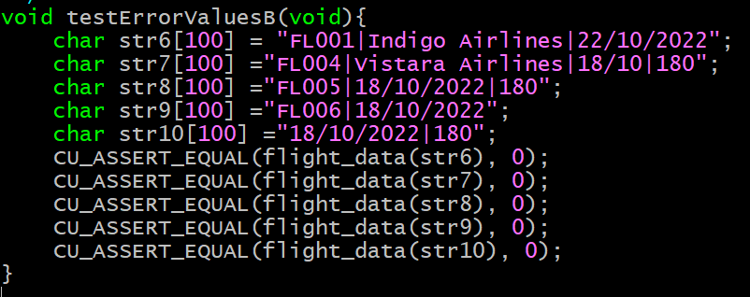
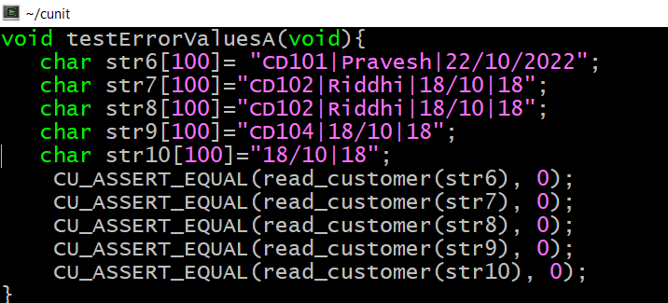
CUNIT

Slide 15
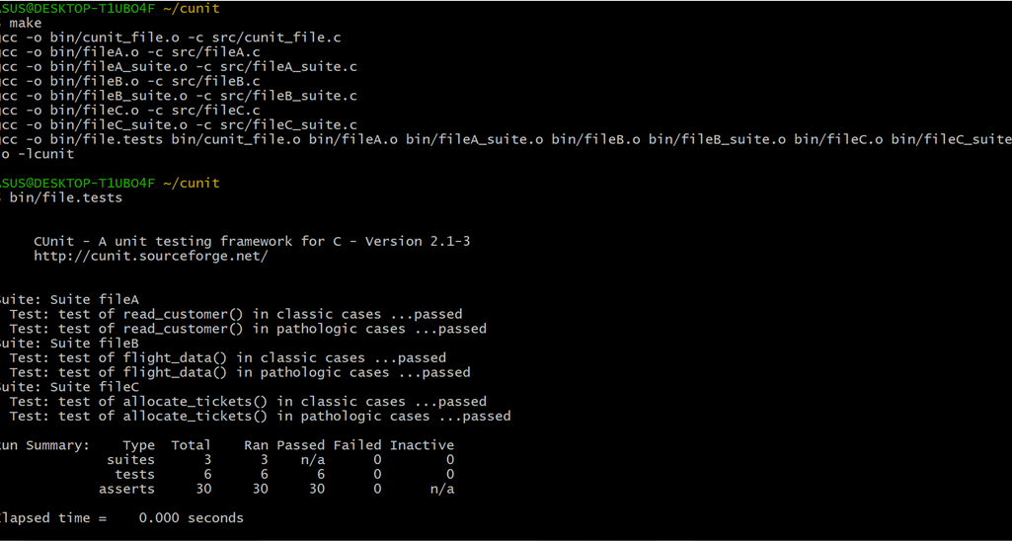
CUNIT

Slide 16
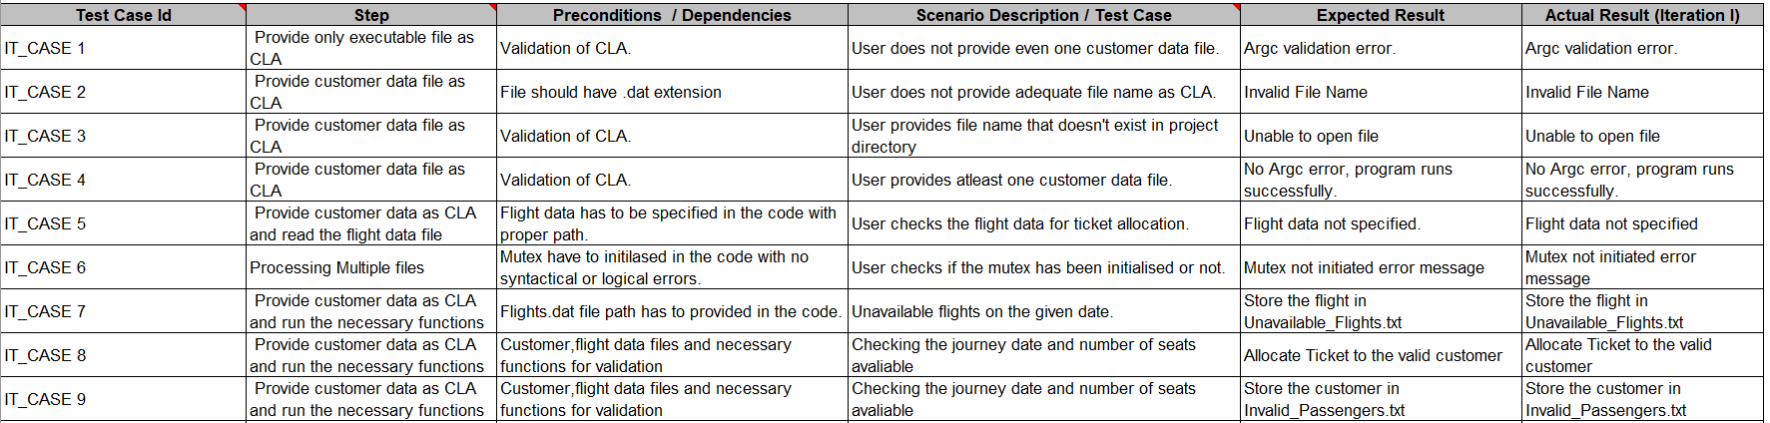
INTEGRATED TESTING

Slide 17
THANKS
Dasari Yashwanthi
Putrevu Nikhil
Chirag Gehi
Pravesh Jhanwar
https://github.com/nikhil2025/Grp4_AirlineReservationSystem

